Slide 1


Bootstrap 5
The Next Generation of Web Development
Notes:
Hello every one. Welcome to Aitrich Academy. Let's get started with Bootstrap today!

Slide 2


Before learning Bootstrap
HTML
CSS
Notes:
Before learning Bootstrap, it's essential to have a solid grasp of HTML and CSS, the foundational building blocks of web development.

Slide 3

Responsive Web Design
Responsive web design (RWD) is an approach to web design that makes websites look good and function properly on a variety of devices, from large desktops to small smartphones.
Notes:
Responsive Web Design
Responsive web design (RWD) is an approach to web design that makes websites look good and function properly on a variety of devices, from large desktops to small smartphones.
RWD is a crucial approach for modern web design. By ensuring your website adapts to different devices, you can provide a better user experience, reach a wider audience, and achieve your website's goals more effectively.

Slide 4
What is Bootstrap
Bootstrap is a widely-used front-end framework used to build responsive user interfaces.
It provides a collection of pre-built HTML, CSS and javascript components and utilities.
Bootstrap simplifies the process of creating consistent and professional-looking web interfaces by offering a wide range of ready-to-use UI components
Notes:
What is Bootstrap
Bootstrap is a widely-used front-end framework used to build responsive user interfaces.
It provides a collection of pre-built HTML, CSS and javascript components and utilities.
HTML Components include
Navigation elements: Navbars, breadcrumbs, dropdown menus, etc.
Forms: Input fields, labels, buttons, etc.
Buttons: Various styles and sizes.
CSS Utilities
Pre-defined classes for styling elements
Responsive design
JavaScript Plugins:
Carousels,Tooltips,Modals
Bootstrap simplifies the process of creating consistent and professional-looking web interfaces by offering a wide range of ready-to-use UI components

Slide 5

History of Bootstrap
Bootstrap, originally named Twitter Blueprint ,was developed by Mark Otto & Jacob Thornton at Twitter.
Bootstrap was released as Open source project on August19,2011
Notes:
History of Bootstrap
Bootstrap, originally named Twitter Blueprint, was developed by Mark Otto and Jacob Thornton at Twitter.
Officially released on August 19, 2011 as an open-source project.
Gained rapid popularity among developers due to its ease of use and focus on responsive design.
Bootstrap 2 introduced a responsive stylesheet as an optional feature.
Bootstrap 3 rewrote the framework to be responsive by default with a mobile-first approach.
Bootstrap 4 further refined the grid system and introduced new components and utilities.
Bootstrap 5 focused on accessibility, performance improvements, and a more modular architecture.

Slide 6
Benefits of Bootstrap
Responsive Design:
Bootstrap is built with a mobile-first approach, ensuring that websites and web applications created with it are responsive and adapt well to various screen sizes.
Time Efficiency:
Bootstrap provides a wide range of pre-built components and templates, allowing developers to quickly prototype and build web interfaces.
Consistency and Uniformity:
By using Bootstrap, developers can ensure that their websites have a cohesive look and feel, with consistent typography, spacing, and color schemes.
Notes:
Benefits of Bootstrap
Responsive Design: Bootstrap is built with a mobile-first approach, ensuring that websites and web applications created with it are responsive and adapt well to various screen sizes. This is important in today's world where more and more people are accessing the internet from their smartphones and tablets.
Time Efficiency: Bootstrap provides a wide range of pre-built components and templates, allowing developers to quickly prototype and build web interfaces. This can save developers a lot of time and effort, especially when working on large or complex projects.
Consistency and Uniformity: By using Bootstrap, developers can ensure that their websites have a cohesive look and feel, with consistent typography, spacing, and color schemes. This can help to improve the user experience and make the website more professional.
Other benefits: Bootstrap is also easy to learn and use, has a large and active community, and is free to use.

Slide 7
Cross-Browser Compatibility: Bootstrap has been extensively tested across different web browsers, ensuring compatibility and consistent rendering across major browsers
Customization:
Developers can easily modify and tailor the framework to match their project's specific requirements.
Notes:
cross-Browser Compatibility: Bootstrap has been extensively tested across different web browsers, ensuring compatibility and consistent rendering across major browsers.
Customization:Developers can easily modify and tailor the framework to match their project's specific requirements.

Slide 8

What's New in Bootstrap 5
Removed jQuery dependency: Bootstrap 5 no longer relies on jQuery.
Enhanced grid system: More flexible and customizable grid layout.
Updated default typography: Improved default typography for better readability.
New utility classes: Additional utility classes for spacing, sizing, and more.
Reimagined forms: Redesigned form controls and validation styles.
Notes:
What's New in Bootstrap 5
Bootstrap 5 (the current major version, released in May 2021) has brought with it tons of changes and improvements, including the addition of new components, new classes, new styling for old components, updated browser support, the removal of some old components, and much more.
Enhanced grid system: More flexible and customizable grid layout.
Removed jQuery dependency: Bootstrap 5 no longer relies on jQuery.
Updated default typography: Improved default typography for better readability.
New utility classes: Additional utility classes for spacing, sizing, and more.
Reimagined forms: Redesigned form controls and validation styles

Slide 9


How to Get Started with Bootstrap 5
Set Up Your Development Environment:
Make sure you have a text editor or integrated development environment (IDE) installed on your computer. Popular choices include Visual Studio Code, Sublime Text.
Download Bootstrap:
Visit the official Bootstrap website at https://getbootstrap.com/.Click on the "Download" button to download the latest version of Bootstrap.
You have two options: download the compiled CSS and JavaScript files or download the source files to customize and compile them yourself.
Notes:
How to Get Started with Bootstrap 5
Set Up Your Development Environment:
Make sure you have a text editor or integrated development environment (IDE) installed on your computer. Popular choices include Visual Studio Code, Sublime Text.
Download Bootstrap:
Visit the official Bootstrap website at https://getbootstrap.com/.Click on the "Download" button to download the latest version of Bootstrap.
You have two options: download the compiled CSS and JavaScript files or download the source files to customize and compile them yourself.

Slide 10
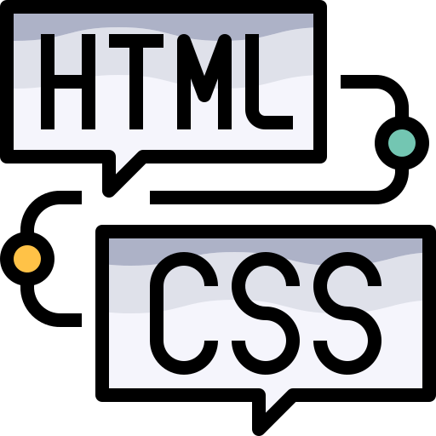


Link Bootstrap in Your HTML File:
Create a new HTML file or open an existing one in your preferred text editor. In the head section of your HTML file, include the Bootstrap CSS file
Just before the closing </body> tag, include the Bootstrap JavaScript file.
Start Using Bootstrap Components:
Notes:
Link Bootstrap in Your HTML File:
Create a new HTML file or open an existing one in your preferred text editor. In the head section of your HTML file, include the Bootstrap CSS file.
Including the Bootstrap JavaScript file just before the closing </body> tag. This is a best practice for several reasons:
Improved Page Loading Performance , Faster Rendering . finally
Start Using Bootstrap Components:

